Slide 1

INVERTED PENDULUM SELF BALANCING CART
USING MATLAB SIMULINK
By Darshan Chotaliya (23070127502), Chaitanya Yenge (23070127506)

Slide 2
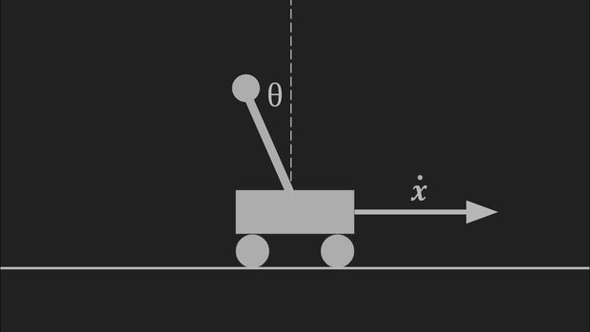
INTRODUCTION
The inverted pendulum is a classic example in the field of control theory, consisting of a pendulum that is mounted on a cart, with the goal of maintaining the pendulum in an upright position by controlling the motion of the cart.

Slide 3
A BRIEF HISTORY
Roberge (1960) demonstrated a solution to the inverted pendulum system at M.I.T. in his aptly named bachelor’s thesis, “The Mechanical Seal”.
Systems with multiple independent inverted pendula were described by Higdon and Cannon (1963) at Stanford.
Stabilization of a pendulum in the inverted configuration by a vertically oscillating base system was included in a series of articles in the American Journal of Physics by Phelps and Hunter (1965), Blitzer (1965), and Kalmus (1970).
The rotary pendulum system was suggested as an alternative to the cart-on-track system by Furuta et al. (1991).

Slide 4
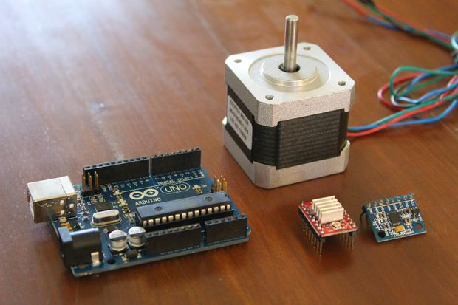
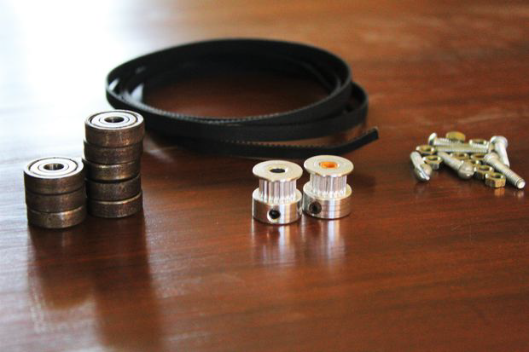
APPARATUS
01
Electronics
Arduino UNO board
Nema17 stepper motor
A4988 stepper motor driver
MPU-6050 Six-Axis
12v 10A power supply
02
Hardware
16 x bearings
2 x GT2 pulleys and belt
2.4 meters of 1.5-inch PVC pipe
4mm nuts and bolts

Slide 5
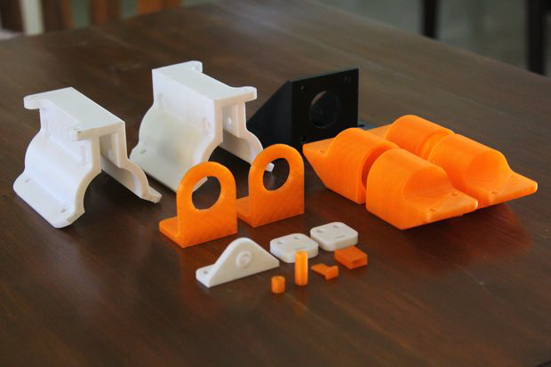
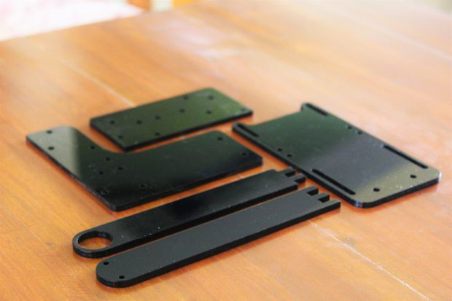
APPARATUS
03
3-D Printed Components
2 x Gantry Roller
4 x End Caps
1 x Stepper Bracket
2 x Idle Pulley Bearing Holder
1 x Pendulum Holder
2 x Belt Attachment
2 x Pendulum Bearing Holder
1 x Pulley Hole Spacer
4 x Bearing Hole Spacer
1 x Gantry Plate
1 x Stepper Holder Plate
1 x Idle Pulley Holder Plate
2 x Pendulum

Slide 6
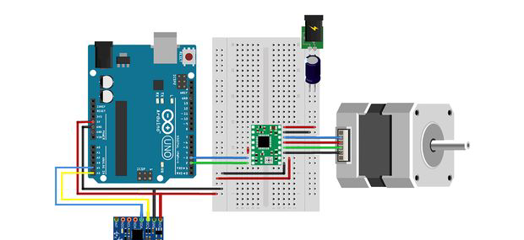
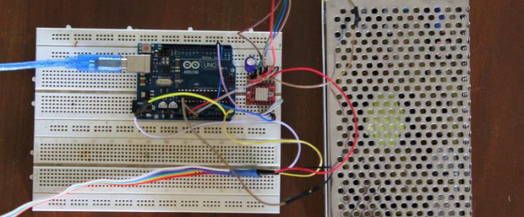
PROCEDURE
01
Wiring and Electronics
MPU6050 to Arduino Connections:
GND to GND
+5v to +5v
SDA to A4
SCL to A5
Int to D2
Stepper Driver to Arduino Connections:
GND to GND
VDD to +5v
STEP to D3
DIR to D2
VMOT to power supply's positive terminal
GND to power supply's ground terminal

Slide 7
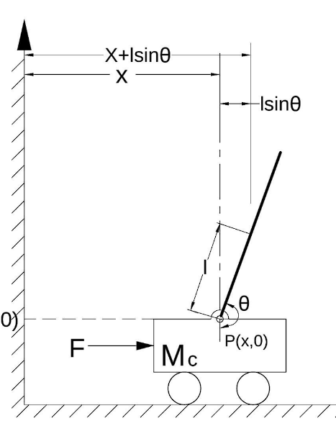
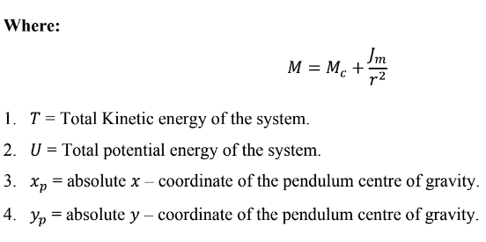
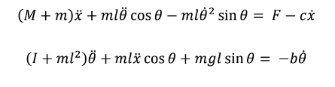
MATHEMATICAL MODELING OF IP SYSTEM(EOM):
Nomenclature
Kinematics of the system

Slide 8
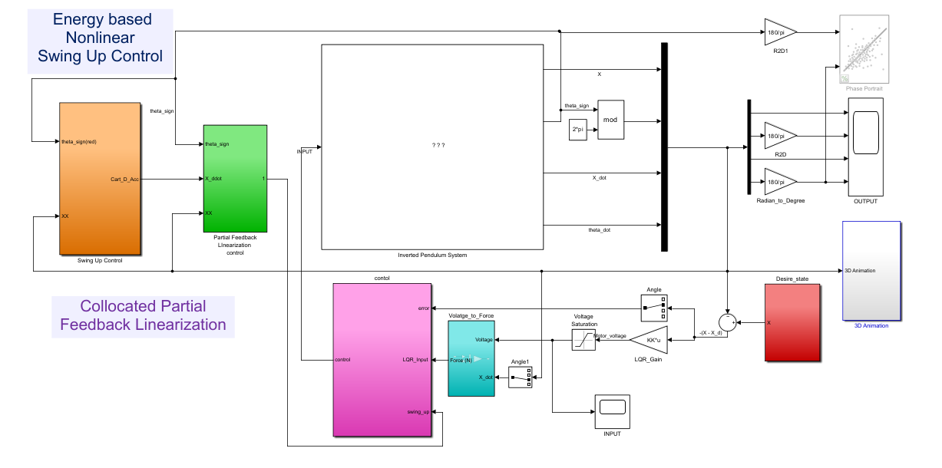
INVERTED PENDULUM SWING UP CONTROLLER DESIGN:

Slide 9
INVERTED PENDULUM SWING UP CONTROLLER DESIGN:
In this section a control scheme is developed for swinging up the pendulum from its vertical downward position. The controller is an energy based controller. Energy-based controller simply control the total amount of the energy in the system such as adding enough energy, the pendulum is swing up from the hanging position to its unstable equilibrium point.
Many different control algorithms can be used to perform the swing up control such as,trajectory tracking, rectangular reference input swing up type. The energy shaping
controller tend to be the most natural to derive and perhaps the most well–known.

Slide 10
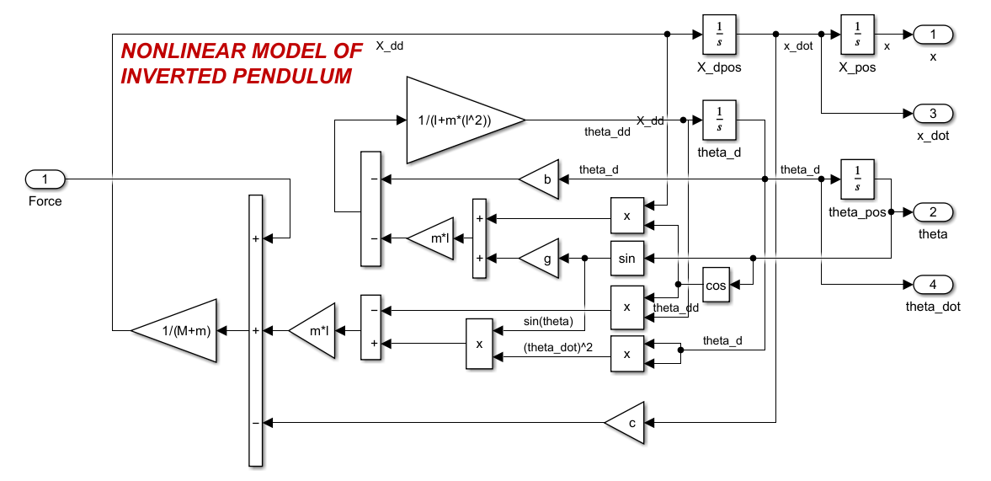
NONLINEAR DYNAMICS OF INVERTED PENDULUM:

Slide 11
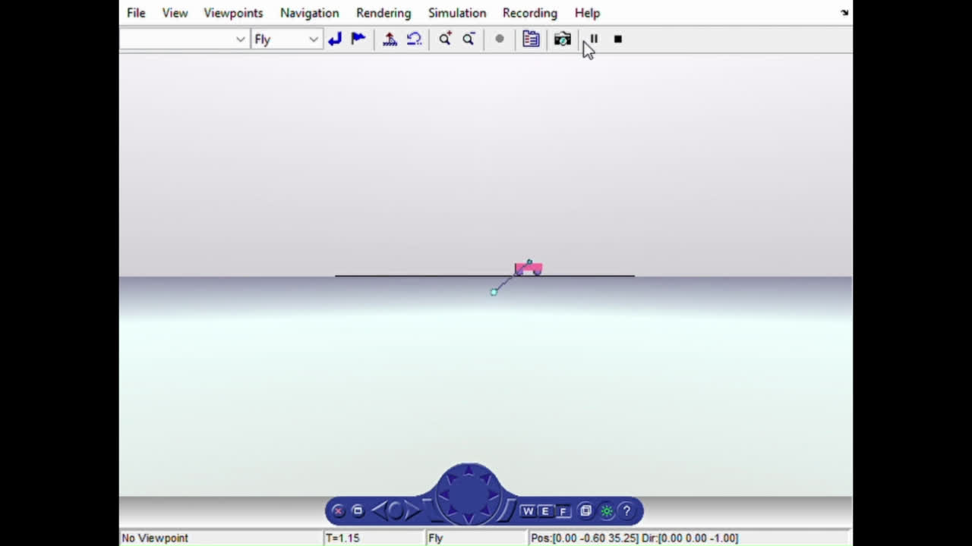
MATLAB SIMULATION
3D VRML Model of Inverted Pendulum:

Slide 12
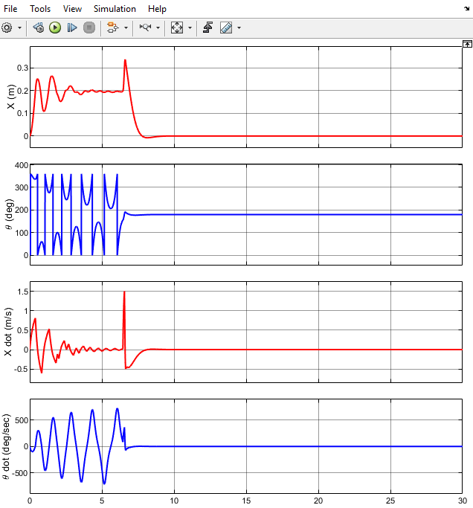
OUTPUT SIGNALS
Stability Test:
To check the stability means to analyze whether the open-loop system (without any
feedback) is stable or not. The eigenvalues of the system state matrix, ‘A’, can determine the
stability. That is equivalent to finding the poles of the transfer function of the system.
AI = ⋋ I.
Where ⋋ is the eigenvalue and I is the eigenvector.The eigenvalues tell us how the matrix A
“acts” in different directions (eigenvectors).
The eigenvalues of the A matrix are the values of s where det(sI − A) = 0.A system is stable
if real part of all its eigenvalues must be lied in the left- half of the s-plane such as negative
number.
>> Poles = eig(A)
ans =
0
-19.6327
6.9178
-5.6006

Slide 13
FUTURE ASPECTS
To Create The Inverted Pendulum setup which consists of a Linearguide
that is made up of aluminium or stainless steel. This linear guide further modified by
adding two Encoders for the measurement of both Linear & angular position. The
Microcontroller we use is Arduino Mega2560.Cytron 10Amp DC motor Driver is used
to drive a motor.

Slide 14
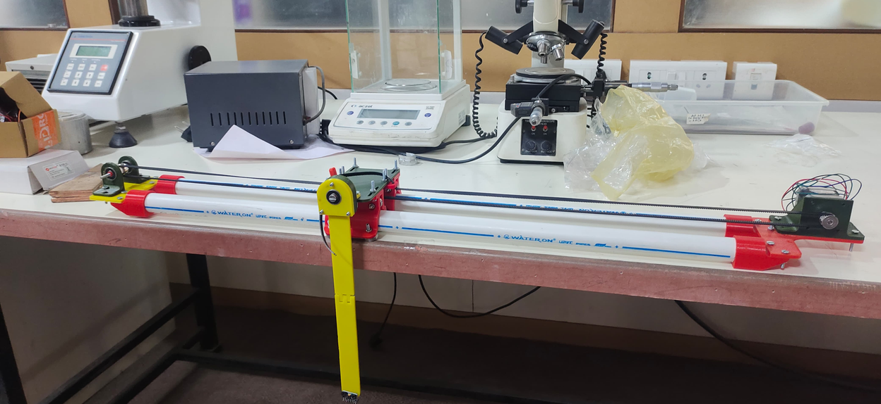
PROCEDURE
02
System Control (Proportional)
The velocity of the cart is proportional to the angle of the pendulum with the vertical.
This can be used to ensure all parts function properly.
The basic Proportional System is robust enough to balance the pendulum and could counter gentle pushes and nudges.
However, there oscillations are noticed in the sensor readings over time that imply the controller was overshooting corrections, which can be corrected by changing the controller type to a Proportional-Integral-Derivative (PID) Controller.

Slide 15
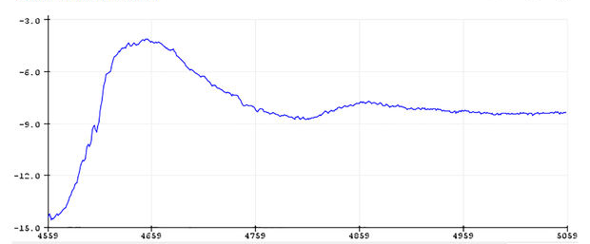
PROCEDURE
03
System Control (PID)
After correct implementation and tuning, the pendulum balanced significantly better as compared to a Proportional system.
The model gains the ability to counter light jolts.
IMU readings displayed over time never strayed far from the desired setpoint.
These factors demonstrate that the new control system is more effective and robust than a basic Proportional Control System.

Slide 16
CONCLUSION
The Inverted Pendulum Self Balancing Cart experiment showcases the effectiveness of control systems in stabilizing unstable systems. Through the implementation of advanced control algorithms such as PID the cart was able to balance the pendulum and counter external disturbances. Overall, this experiment offers valuable insights into the field of control systems and its practical applications in real-world scenarios.

Slide 17
THANK YOU

